Slide 1
Terroir and Drought in the Anderson Valley
Zac Robinson
April 2022

Slide 2
A Different Landscape
TERROIR
Anderson Valley is physically different from Inland Mendocino
climate
terrain / soils
isolated
water sources
presence of endangered species (Coho)

Slide 3
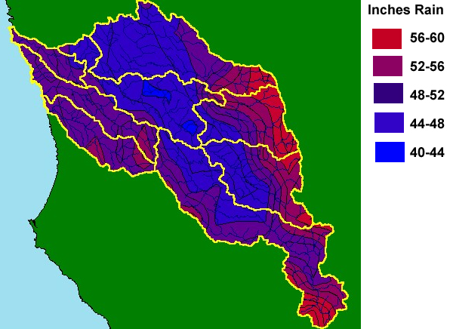
Good Rainfall
Source: Krisweb/Oregon State
TERROIR

Slide 4
Vineyards Are Different
TERROIR
Because AV is physically different, our vineyards look different:
smaller (median 13 acres)
hillside
modern
singular varietal focus

Slide 5
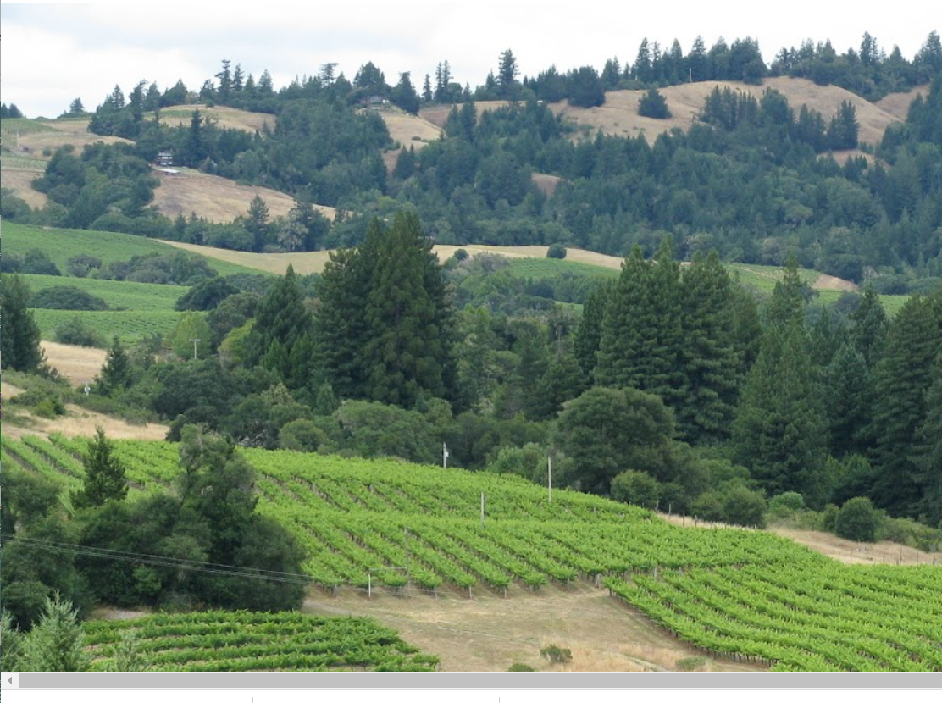
Hillsides, small blocks
TERROIR

Slide 6
What is Water “Security”?
WATER
SECURITY
Water security per United Nations definition
“The capacity of a population to safeguard sustainable access to adequate quantities of acceptable quality water for sustaining livelihoods, human well-being, and socio-economic development, for ensuring protection against water-borne pollution and water-related disasters, and for preserving ecosystems in a climate of peace and political stability.”
Water security per this farmer:
“Enough water to farm this year.”

Slide 7
Inland Water Security
WATER
SECURITY
Inland Mendocino water security can include
surface water diversion
contract with RRFC
purple pipe in Ukiah Valley
Potter Valley project
wells
winter collection to ponds

Slide 8
Anderson Valley Water Security
WATER
SECURITY
In Anderson Valley the options for water security
are much more limited
surface water diversion
contract with RRFC
purple pipe in Ukiah Valley
Potter Valley project
wells
winter collection to ponds

Slide 9
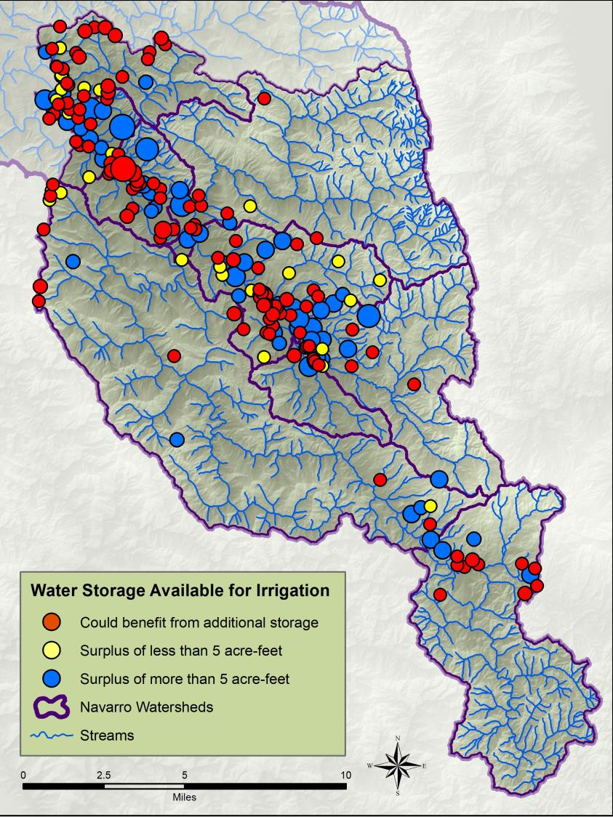

Analysis of AV Vineyard Water Security
WATER
SECURITY

Slide 10
Getting More From Our Ponds
REDUCE
DEMAND
Reduce Demand←
Irrigation efficiency
Alternative methods of frost protection
Increase Supply
Reduce leakage
Reduce evaporation

Slide 11
Demand Reduction - Efficiency
REDUCE
DEMAND
We improve water security when we reduce
our demand for water.
Modern/efficient drip irrigation systems
  Dual drip lines
  Soil moisture monitoring
Precision irrigation
  Smaller blocks

Slide 12
Demand Reduction – Frost Nights
REDUCE
DEMAND
Anderson Valley is re-discovering wind machines for light frost events. Installations can be budgeted like a water purchase. One case study:
$100k investment
20 acres
two annual frost events for 10 years
= 254 acre feet of water saved
=$400/AF

Slide 13
Getting More From Our Ponds
INCREASE
SUPPLY
Demand Reduction
Irrigation efficiency
Alternative methods of frost protection
Increase Supply ←
Reduce leakage
Reduce evaporation

Slide 14
Supply Improvements – Pond Liners
INCREASE
SUPPLY
Projects to reduce pond losses can be budgeted like buying water. One recent liner installation of a 3 AF pond
$60k investment
2 AF annual leakage
assume 30 years of life
= 60 acre feet of water saved
=$1000/AF

Slide 15
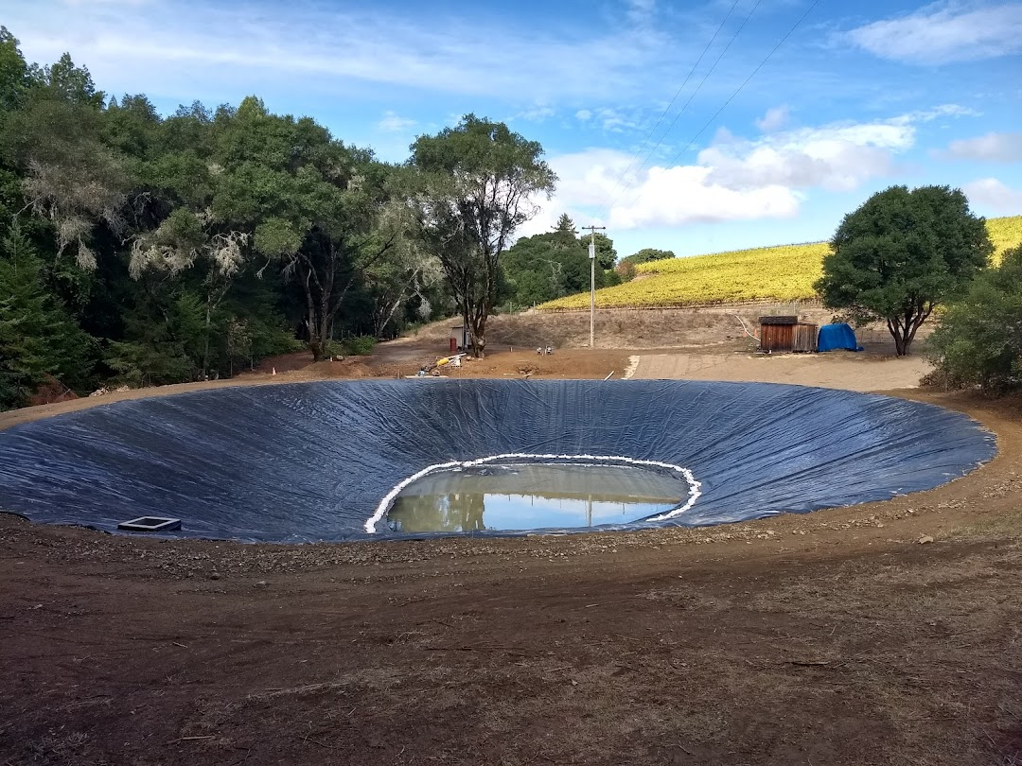
Old Pond, New Liner
INCREASE
SUPPLY

Slide 16
Evaporative Losses
INCREASE
SUPPLY
In the winery, evaporative losses are “The Devil’s Share.” The same applies to the vineyard.
1/3 inch on a hot breezy summer day!
3 ft over a typical summer
In an example pond this is 34% loss of storage

Slide 17
Evaporation Research
INCREASE
SUPPLY
Evaporation from surface water is controlled
by many factors. The simple list includes:
Air temp and humidity
Water temp
Wind speed
Reservoir geometry

Slide 18
Evaporation Research
INCREASE
SUPPLY
Factors we can control for our ponds.
Air temp and humidity
Water temp
Wind speed
Reservoir geometry

Slide 19
Reducing the “Devils Share”
INCREASE
SUPPLY
Reduce your surface water temperature
Shade trees
Shade cloth
No dyes!!!
Reduce the wind speed
Shade trees
Curtains

Slide 20
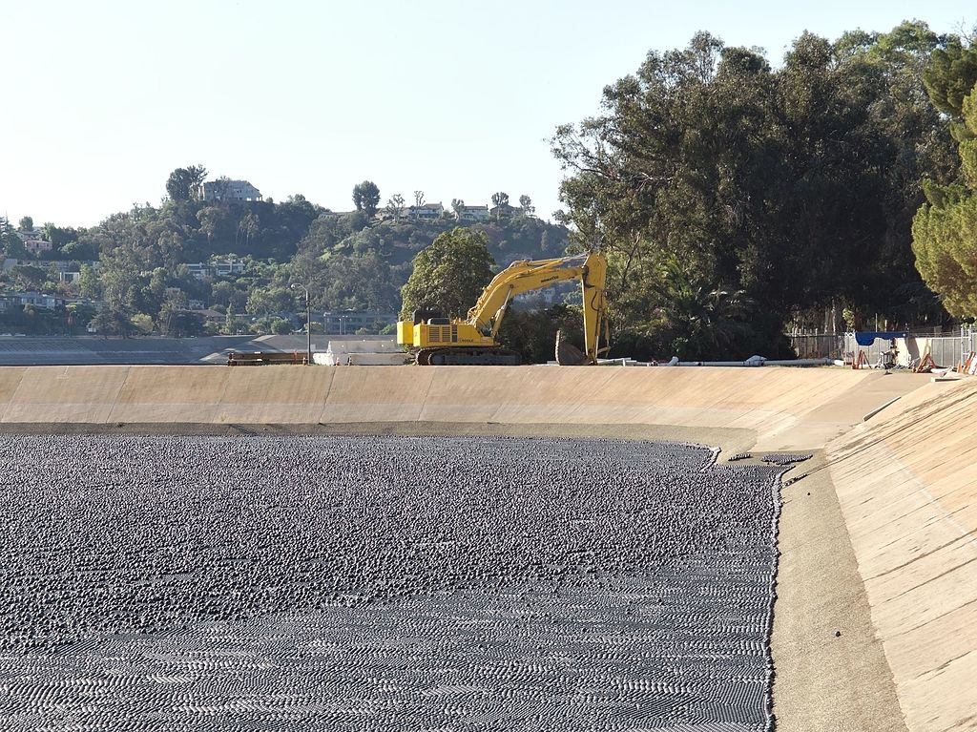
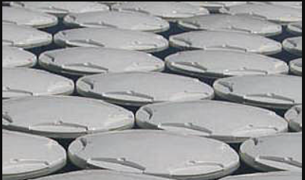
Pond Covers
INCREASE
SUPPLY
Kick the Devil out of town! Change the geometry of your pond by eliminating the surface area!
Shade Balls
Aqua Caps
Azolla doesn’t count!

Slide 21
Pond Covers II
INCREASE
SUPPLY
Ponds can be sealed with chemical covers
WaterSavr – 20% savings with 3 applications per week. With a 5 AF pond this is 1/3 AF of water savings.
Aquatain https://aquatain.com
Vegetable Oil

Slide 22
Pond Covers III
INCREASE
SUPPLY
Change the geometry: Eliminate half of our surface area with floating “tarps”? Assume:
$2000 to cover half of a 5AF pond
50% evaporation reduction.
Water savings = 0.8AF/annual for 5 years
= $500/AF saved.

Slide 23
Partnership
INCREASE
SUPPLY
Coho as a blessing … introducing farmers to new partnerships for common goals.
  RCD, Nature Conservancy
  Projects to build storage
  Regulatory common sense
  Connections with grant funding

Slide 24
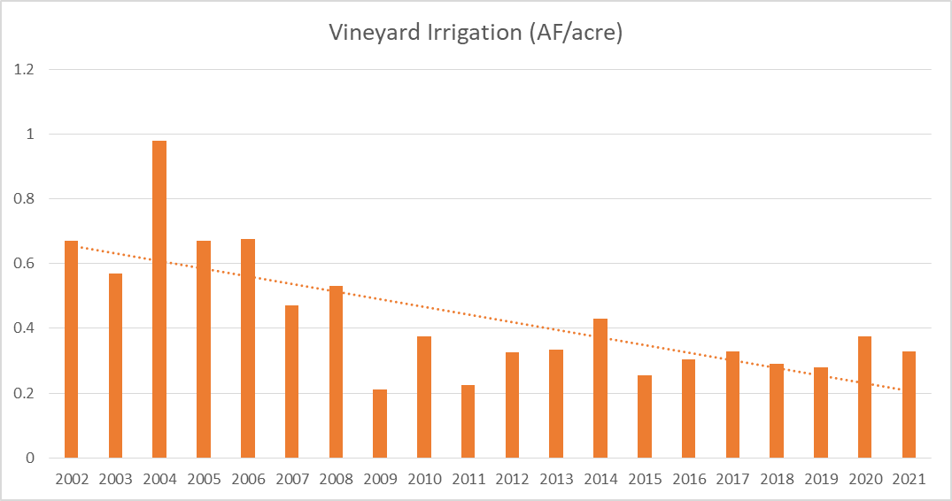
Learning From Each Drought
SUMMARY
For Anderson Valley water security might actually be improving with each drought

Slide 25
Summary Drought 2022
SUMMARY
Unlikely to be a “crisis” in Anderson Valley
Probably a “sqeeze” year for some
Definitely a marketing opportunity

Slide 26
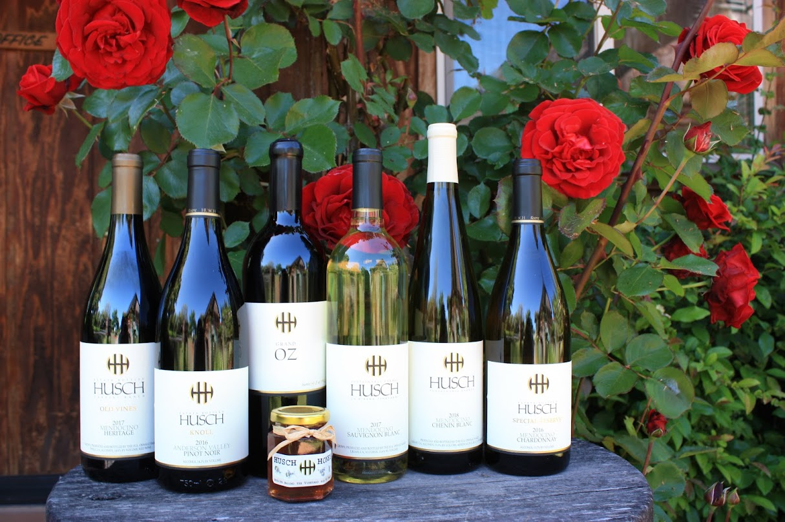
Droughts Make Great Wine
SUMMARY

